Slide 1

Microsoft identity platform
Developer community call
Authentication in collaborative apps with Microsoft Teams and Microsoft Identity
Kyle Marsh
Principal Program Manager Microsoft Entra App Dev Architecture
June 16, 2022 | 9:00AM PT / 6:00PM CET

Slide 2


Introduction
First things first
Please note: We are recording this call so those unable to attend can benefit from the recording.
This call is designed for developers who implement or are interested in implementing Microsoft identity platform solutions.
What kind of topics will we discuss?
We will address development related topics submitted to us by the community for discussion.
We build a pipeline of topics for the next few weeks, please submit your feedback and topic suggestions - https://aka.ms/IDDevCommunityCallSurvey
View recordings on the Microsoft 365 Developer YouTube channel - https://aka.ms/M365PnP/videos
Follow us on Twitter @Microsoft365Dev and @azuread
This is NOT a support channel. Please use Stack Overflow to ask your immediate support related questions.
When is the next session?
Community Calls: Monthly – 3rd Thursday of every month
Next Identity Developer Community Call: July 21st

Slide 3
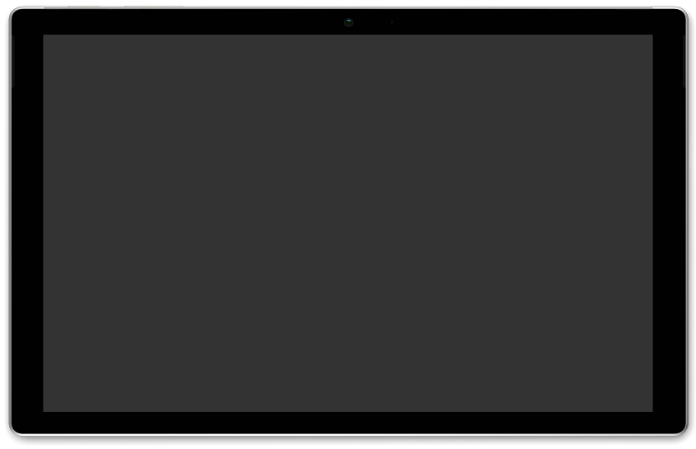


Authentication in collaborative apps with Microsoft Teams and Microsoft Identity
– Kyle Marsh (Microsoft)
AGENDA
Microsoft Identity dev community call 16th of June
Download recurrent invite from https://aka.ms/IDDevCommunityCalendar
Notes:
Dan’s slide

Slide 4
Environment
Teams or Outlook or Office.com authenticate the user with Microsoft Entra
Azure AD native user, Guest Business to Business user, Microsoft Account
Teams apps can authenticate the user to their system by asking Teams who the user is
On-premise apps used to ask Windows, the OS, who the current user is.
Teams apps (Outlook, Office.com) can ask Teams who the user is.

Slide 5




Teams SSO
Authenticates user
Acquire token for Teams App
Azure AD
Teams SDK
JW Token
getAuthToken
Neither OIDC nor SAML. Just an API call
Teams App

Slide 6
Teams SSO
Azure AD
Teams SDK
Really an access token for Teams to access your app.
Teams (Outlook, Office.com) is the client app
Your app is the resource
JW Token
Teams App

Slide 7
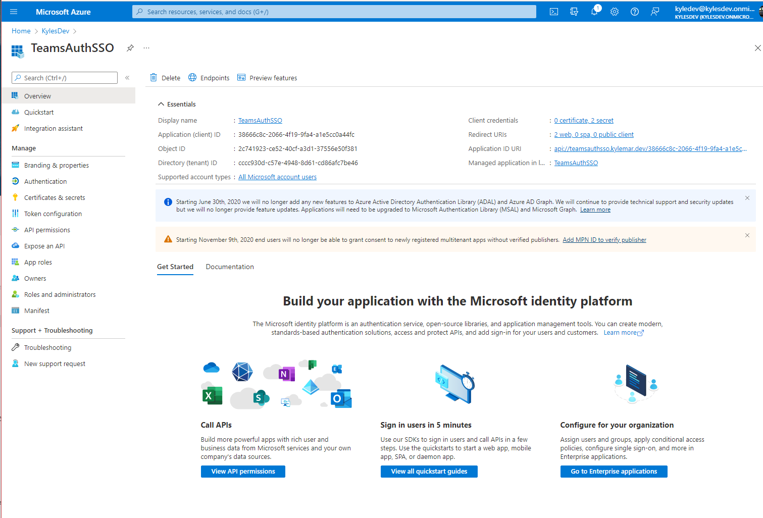

Slide 9
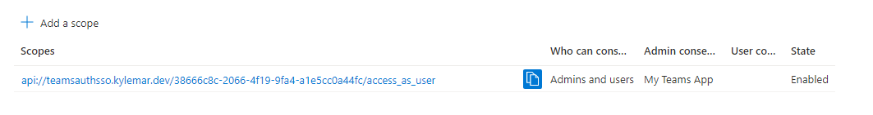

Slide 10
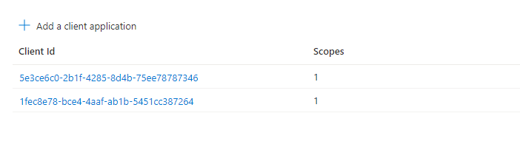
Authorized client applications

Slide 11
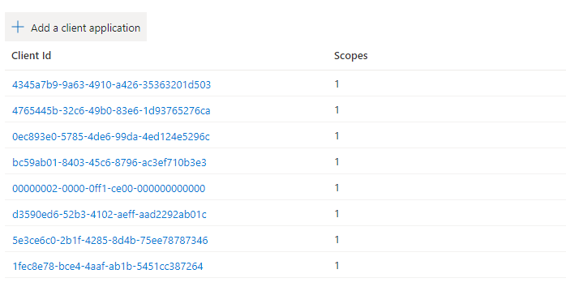
More authorized client applications

Slide 12
Teams SSO
Azure AD
Teams SDK
Locate user with tid+oid
If found, Consider the user authenticated and proceed
JW Token
Teams App

Slide 13
Teams SSO
Azure AD
Teams SDK
If the user (tid+oid) is not found have the user authenticate existing IDP.
Add tid+oid to user object in app system
JW Token
Teams App
Don’t match on values that changed or can be spoofed

Slide 14
Where do your users come from?
Personal account
kylemar@outlook.com
Corporate License
Kyle.marsh@microsoft.com
Personal account that used corporate email
Kyle.marsh@microsoft.com
User in their home tenant
User as a guest in a different tenant using corporate ID
User as a guest in a different tenant using their personal account
Be prepared for a many to many relationship for account linking

Slide 15
Just need to authenticate the user?
Stop now.
To call an API, any API, protected with Microsoft Entra you need a different token
2 choices
On behalf Of from a secure back end - preferred
Regular OAuth2 request from client

Slide 16
On Behalf Of

Slide 17
Teams Authorization
Azure AD
Teams SDK
OAuth2 On Behalf Of
Client Creds
JW Token
Teams App

Slide 18

Teams Authorization
Client Creds
JW Token
Azure AD
Teams SDK
OAuth2 On Behalf Of
Access Token
Teams App

Slide 19

Teams Authorization
Azure AD
Teams SDK
Access Token
Teams App

Slide 20
Teams Authorization
Azure AD
Teams SDK
Teams App
Access Token
Microsoft Graph

Slide 21
On Behalf Of

Slide 22
Teams Authorization
Azure AD
Teams SDK
OAuth2 request
Over Teams SDK authentication UI
Client Creds
Effectively another authentication
SSO may, or may not kick in
Only option for SPA
Teams App

Slide 23
Questions

Slide 24
Thank you
Recording will be available soon on the
Microsoft 365 Community (PnP) YouTube channel
https://aka.ms/M365PnP/videos
(subscribe today)
Follow us on Twitter
@Microsoft365Dev and @azuread
Next call: July 21st at 9:00am PST
https://aka.ms/IDDevCommunityCalendar

